Slide 1
Artificial Intelligence for Small Business

Slide 2
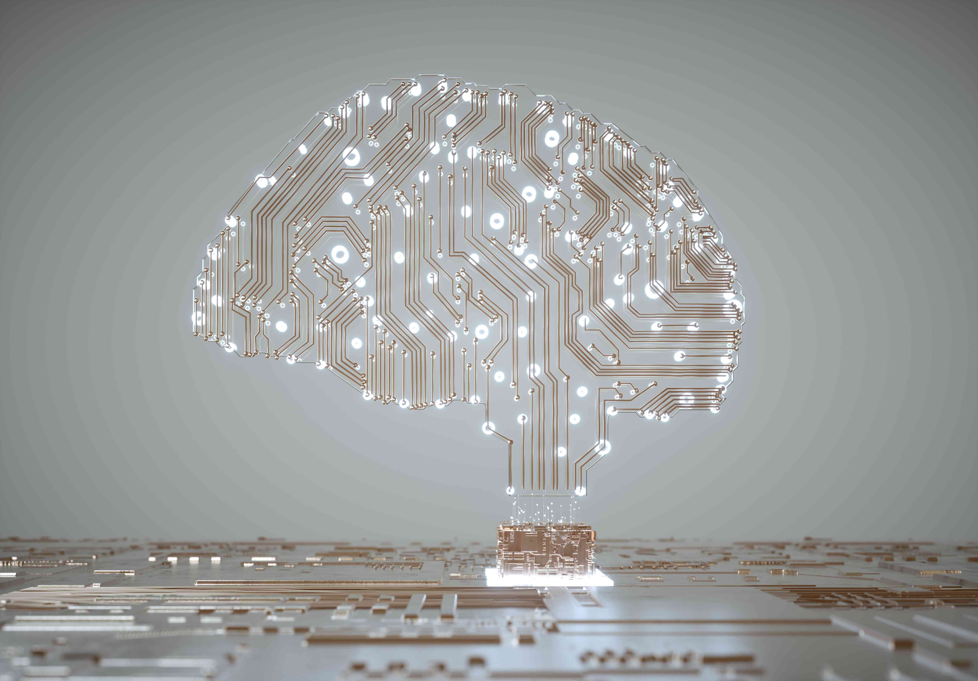
AI: What is it?

Slide 3
Artificial intelligence, first imagined in 1950, uses computers and machines to mimic the problem-solving and decision-making capabilities of a human.

Slide 4
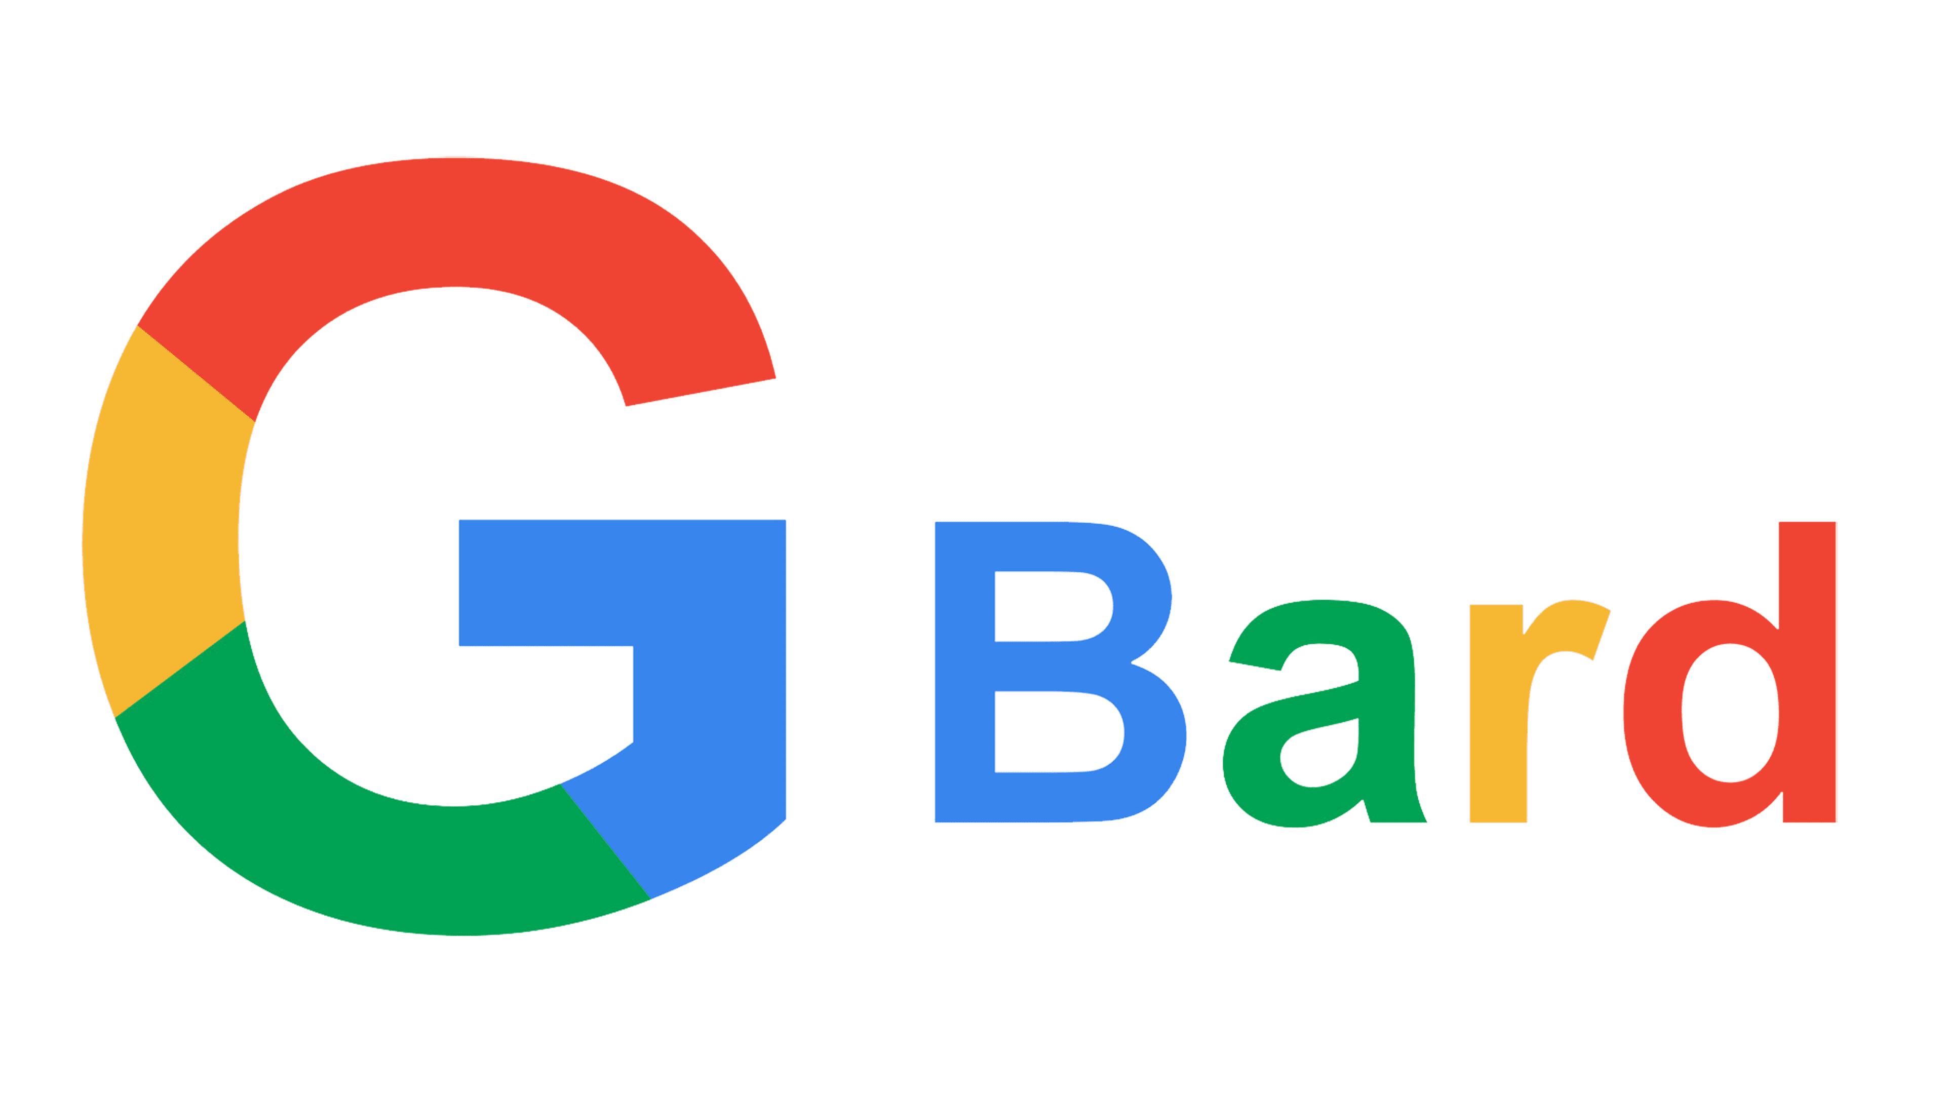
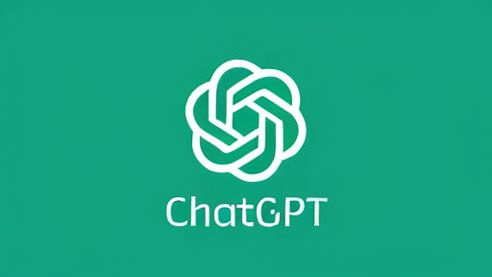
The two best-known AI "websites are:

Slide 5
There are two basic types of AI:
Weak AI:
Strong AI:
A machine has the intelligence equaled to a human. it would have a self-aware consciousness that has the ability to solve problems, learn, and plan for the future.

Slide 6
How do we use AI now?
Customer service: Slack and Facebook Messenger.
Computer vision: Photo tagging in social media and self-driving cars.
Recommendation engines: When Amazon serves add-on recommendations to us while we check out.

Slide 7
Marketers use it to write copy. Students use it to cheat on finals.

Slide 8
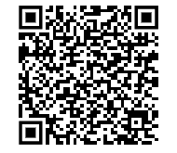
How we can use AI in our everyday lives...
https://www.microsoft.com/en-us/microsoft-365/business-insights-ideas/resources/how-ai-help-small-business

Slide 9
Chat GPT-4, IBM Watson, Bard and Amazon Comprehend are not great at coming up with things "from scratch."
"Write me a post about ____."
Draft a customer email about____."
Come up with ideas about _____."
The AI has to make too many random decisions which will give you a poor result.

Slide 10
Give it a specific objective
Tell it how to provide the output (the answer)
And remember, it cannot THINK. It can DO. It's a very big set of data which uses our words to provide the answers.
Example. Write your article. Have AI "fix it." Then resubmit the article again. You'll likely be happier with that second result.

Slide 11
Try these fun and helpful AI applications!
Kickresume
Hypotenuse AI (text to image)
Synthesia (make videos)
Gamma.app (Presentations in an instant, looks amazing too
Numerous.ai (Excel is so last year)
Stylized.ai (you draw a pic, it makes it look amazing)
GFP-GAN ( takes old photos and makes them look awesome)

Slide 12
More...
Pictory
Create and edit high-quality videos. You don’t need any experience in video editing.
Murf
An AI voice generator. Convert text to speech, voice-overs, and dictations
or design.
Fireflies
An AI meeting assistant that uses NLP to eliminate the need for note taking during a meeting. Easily record, transcribe, and search across your voice conversations on an intuitive to use platform.
Feathery
Enables users to build highly customizable forms with no coding required.

Slide 13
We are going to do this one of two ways, or a little of both.
AI is going to revolutionize literature, medicine, art, science, cybersecurity...
or it's going to end the human race.

Slide 14
Almost 30,000 people (including Musk and Steve Wozniak) have signed a petition calling for an “immediate pause” to the development of more powerful AI systems.
Some AI leaders have voluntarily testified to Congress about it.
They're scared.

Slide 15
Our take:
AI is great, right now. Bard and Chat GPT are amusing, informing, and teaching us a lot of things. It's a nice timesaver tool, a rich search engine companion, an awesome small business customer success tool as well.
If an evil actor gets access to "Generative AI tools," the human race is 1/10 of a second to midnight.
Play with it. Dive in for an hour. Read trusted news sites about it. Don't lose sleep over it. It's awesome technology – if used for good. We have time to develop it in a just and moral way. And we're nowhere near endgame yet.

Slide 16
Google Analytics in 10 slides

Slide 17
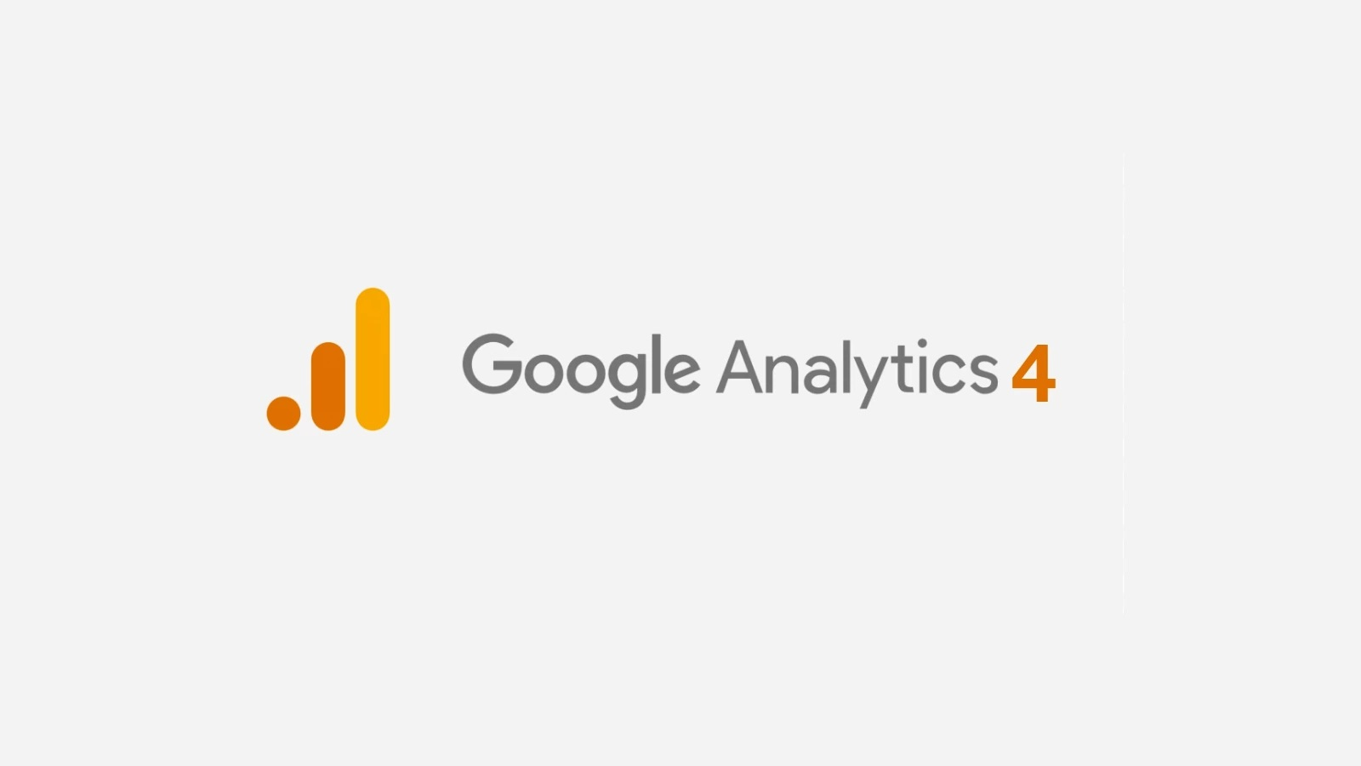
If you've never used GA, now is a good time to start. You want to know where your marketing efforts are landing, and where you're succeeding. It is a feature-rich tool designed to provide at-a-glance information about how your online offerings are performing.
The next generation of Google Analytics is designed to give you insights on everything you publish online: insights on your app, your website as well.

Slide 18
It uses artificial intelligence as well.

Slide 19
Analytics provides critical information about
"who's doing what, where, and how."
Clicks and pageviews on your website
Installs and opens on your app
User engagement and conversions on either platform

Slide 20
<!-- Google tag (gtag.js) --> <script async src="https://www.googletagmanager.com/gtag/js?id=G-HYKRH6LFZR"></script> <script> window.dataLayer = window.dataLayer || []; function gtag(){dataLayer.push(arguments);} gtag('js', new Date()); gtag('config', 'G-HYKRH6LFZR'); </script>
This is the way Google Analytics "hears" your website. Code which looks like this is pasted "into" your website. When activated, it starts sending user data to your analytics dashboard.

Slide 21
GA4 is not easy to manage. The engineers who designed it did not use plain English, and the myriad options can frustrate a user who wants a simpler, top-line view of their web traffic.
It is, however, an essential tool for a merchant to see what's working online, and what needs to change.
We are advanced Google Analytics data specialists. Ask us to get you set up, or contact us to help you make sense of what you've
already created!
Our initial consultation is free, of course. john@johnscottmedia.com

